Slide 1
Defense Health Agency
Industry Exchange
J-6 I&O’s Enterprise Approach by
COL Beverly Beavers
November 08, 2018

Slide 2
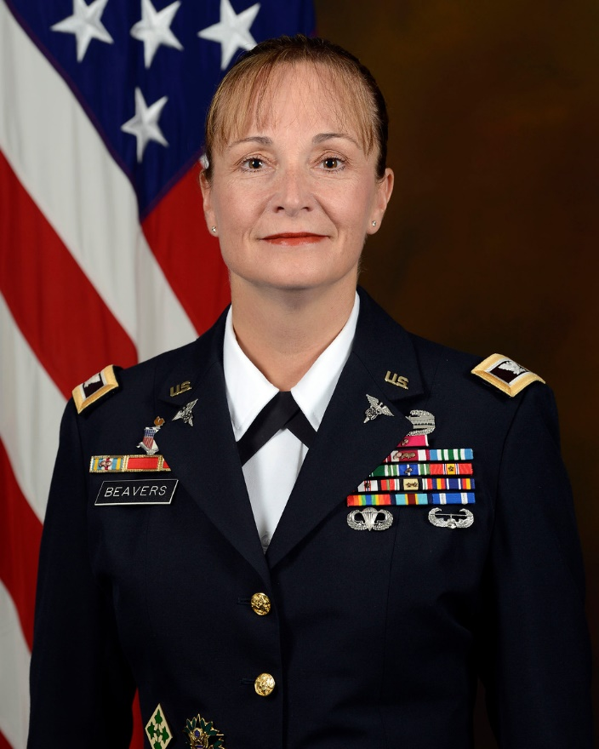
Speaker Introduction
Beverly Beavers, COL, MSC, USA
Chief, Infrastructure & Operations Division
Deputy Assistant Director, Information Operations (DAD IO/J-6)
COL Beavers is the leader for the sustainment strategy and efforts for the D2D. COL Beavers joined the DADIO/J-6 after serving as the Army Medicine CIO/G6 from February 2015 until July 2017. Prior to this assignment COL Beavers served as the Information Technology Strategic Sourcing Analyst, Component Acquisition Executive for the Defense Health Agency, in Arlington, Virginia.

Slide 3







I&O Division At-A-Glance
Mission: To deliver and sustain flexible and efficient cyberinfrastructure services in support of healthcare delivery for the MHS by identifying and implementing proven advances in technology
Data Centers
  Wide area network (WAN)
  Datacenter services (global availability, systems support)
  Pacific and Europe regions network services
Deployment & End User Device Support
  Desktop deployment
  General desktop support
  Network related issues (local connection problem, network access, e-mail, internet)
Gateway Connections
MHS commercial business partners connectivity
Real-time healthcare data
exchange
Business-to-Business
Veterans Administration
Network Protections
  Network protection suites providing key security protections
Deployment & Transition
Local Area Network (LAN)
Enterprise-wide DS/EM
Vision: To support and enhance the health of our warfighters and their families across the continuum of care by securely connecting providers, patients, and information
3

Slide 4
Principles – DHA Overarching Strategy
Vision: Unified and Ready
Mission: The Defense Health Agency, a Combat Support Agency, leads the MHS integrated system of readiness and health to deliver Quadruple Aim: increased readiness, better health, better care, and lower cost.

Slide 5
Operational Strategy
M1
Optimize Critical Management Processes
Create robust improvement capability
W4
Unify and fully integrate enterprise support activities
W3
Develop and prioritize requirements
W5
Manage and administer MTFs
W1

Slide 6
Operational Excellence
Sustainably containing costs while increasing operational throughput
Sustainability
Cost Optimization
Organizational Growth
The Right Job,
the Right Way
– Every Time.

Slide 7

Path to Operational Excellence
Standardized processes
Measure who, what, where and why
Gather experiential data
Drive continuous improvement that focuses on
  Value-adding activities
  Done where the most value is added
React
Organize
Scale
Optimize

Slide 8

Path to Service Excellence
Standardized infrastructure
Standardized, consistent, and optimized processes
Fully integrated, component to service monitoring
Quality-based performance measures (business value, not component up/down)
Situational Service Level Agreements

Slide 9
Operational Evolution
Infrastructure and Operations (I&O) Division’s support must evolve to meet our changing environment
  Maturing DHA Organization
    DHA Reorganization
    Impacts of Zero-based Budget Reviews
    National Defense Authorization Act (NDAA)
    Military Health System (MHS) Information Technology (IT) Reform
  Preparing for the implementation & sustainment of MHS GENESIS
  Rebaselining and Deployment of D2D

Slide 10
Challenges
Challenges
Defense Health Agency (DHA) facing resource reductions
  DoD Infrastructure Technology (IT) Reform initiative driving over $1.5B decrement to the Military Health System (MHS) across the FYDP
  DHA implementing plans to achieve IT savings
    Through shared services, network modernization, electronic health record (EHR) modernization and manpower reductions
  At the same time must deal with cost increases
    Delays in medical network and EHR modernization
    Increase in scope to address non-clinical other lines of business and the mandatory upgrade to the new cyber security standards
Projected efficiencies are short of projected reductions
Streamline duplicative functions within footprint in order to obtain cost optimization

Slide 11
Strategic Infrastructure Operations & Sustainment Roadmap
Strategic Infrastructure Operations & Sustainment Roadmap
(NE&S) Network Engineering & Sustainment (Awarded Q1 FY19)
(NSS) Network Support Services (New Award Q1 FY20)
(GSC) Global Service Center (Award Q1 FY21)
Enterprise Services Branch Operations & Sustainment Support (Award in Q2 FY19)
Q2 FY19
Q4 FY19
Q2 FY20
Q4 FY20
Q2 FY21

Slide 12
End State: Revamp of Premier Enterprise Capabilities
End State: Revamp of Premier Enterprise Capabilities
Cost Optimized and streamlined operations model
IT Tools Rationalization Complete
Industry creating strategic partnerships to close capability gaps
Transformation of Training Strategies
Agility in delivering new cost models and speed-to-market services

Slide 13

Questions/Discussion
Questions/Discussion

